Slide 1
Budget Text Processing

Slide 2
Overview
Analyzing Budget text for counties and cities:
Guilford County
Wake County
Mecklenburg County
Durham County
City of Charlotte
City of Durham
City of Raleigh

Slide 3
Goals
Understand/Analyze Budget Text Data
Data Cleaning/Pre-processing
Topic Modeling of Budget Texts
Emotion and Sentiment Analysis of Budget Texts
Next work recommender for the texts in Budget

Slide 4
Teams Structure
Team 1: Topic Modeling
Members:
Team 2 : Emotion and Sentiment Analysis
Members:

Slide 5
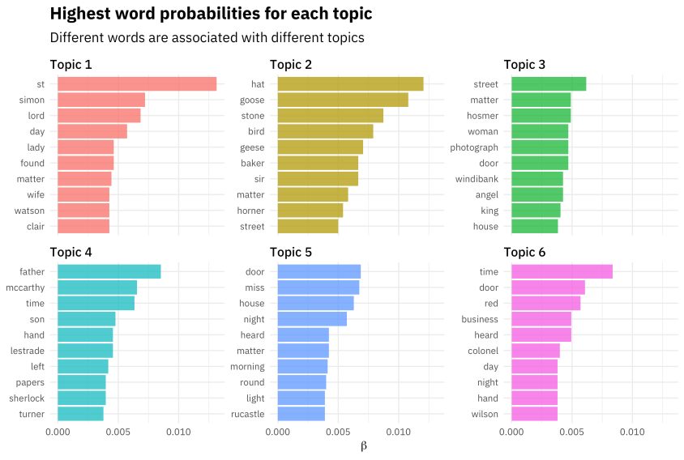
Topic Modeling Topic modeling can be described as a method for finding a group of words (i.e topic) from a collection of documents that best represents the information in the collection. It can also be thought of as a form of text mining – a way to obtain recurring patterns of words in textual material.
Contributors :
Naseeb
Sultan
Miguel

Slide 6
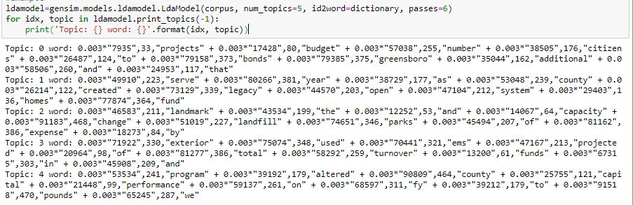
Topic Modeling

Slide 7

Emotion and Sentiment Analysis Sentiment analysis and emotional analysis are two key methods experts use to quantify audiences’ emotional engagement. You can use them in your content strategy to unveil readers’ emotional responses to your content. If you manage to uncover how people feel about your content, you can easily make it perfect.
Contributors:
Akash
Unnati Khivasara

Slide 8
Next Word Recommender(optional)
Whenever a user tries to enter a word/s suggest the next word based on combination of words used as input in previous searches.
Naseeb
Akash
Sultan
Unnati Khivasara
Miguel Gaspar

Slide 9
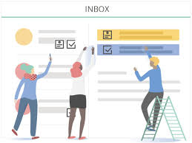
Tasks
Data segregation: Akash, Sultan
Data Cleanup: Naseeb, Unnati, Akash, Miguel
Data Organization: Akash, Miguel
Research on finalizing suitable approach /techniques used for analysis: Naseeb, Unnati, Miguel
Preparing Documents: Unnati, Sultan
Preparing Document Term Matrix: Sultan, Naseeb
Analysis : Everyone

